Slide 1

Code Crate
A Password Manager by Data Forge LLC.
Phase 2 Presentation
Notes:
Opening by Connor

Slide 2
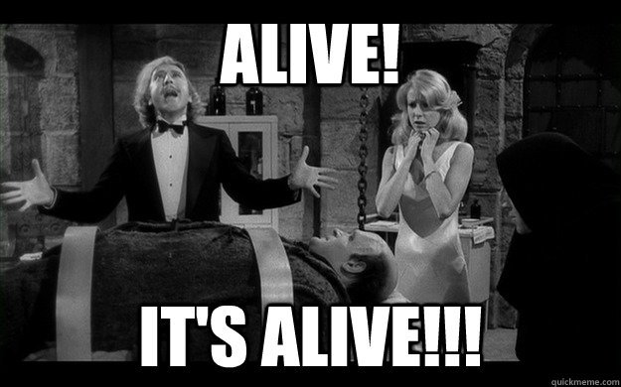
The short version...
Young Frankenstein, Mel Brooks. 1979

Slide 3
User interface
One of our goals in this project was to have a responsive web design, which means our application can be used on any device's web browser.
We also wanted a user-friendly web design to where the user doesn't feel overwhelmed.
With Blazor with can have snappy web components and features.
Notes:
Show images of the front end in a laptop web browser, a tablet screen, and a smartphone.

Slide 4

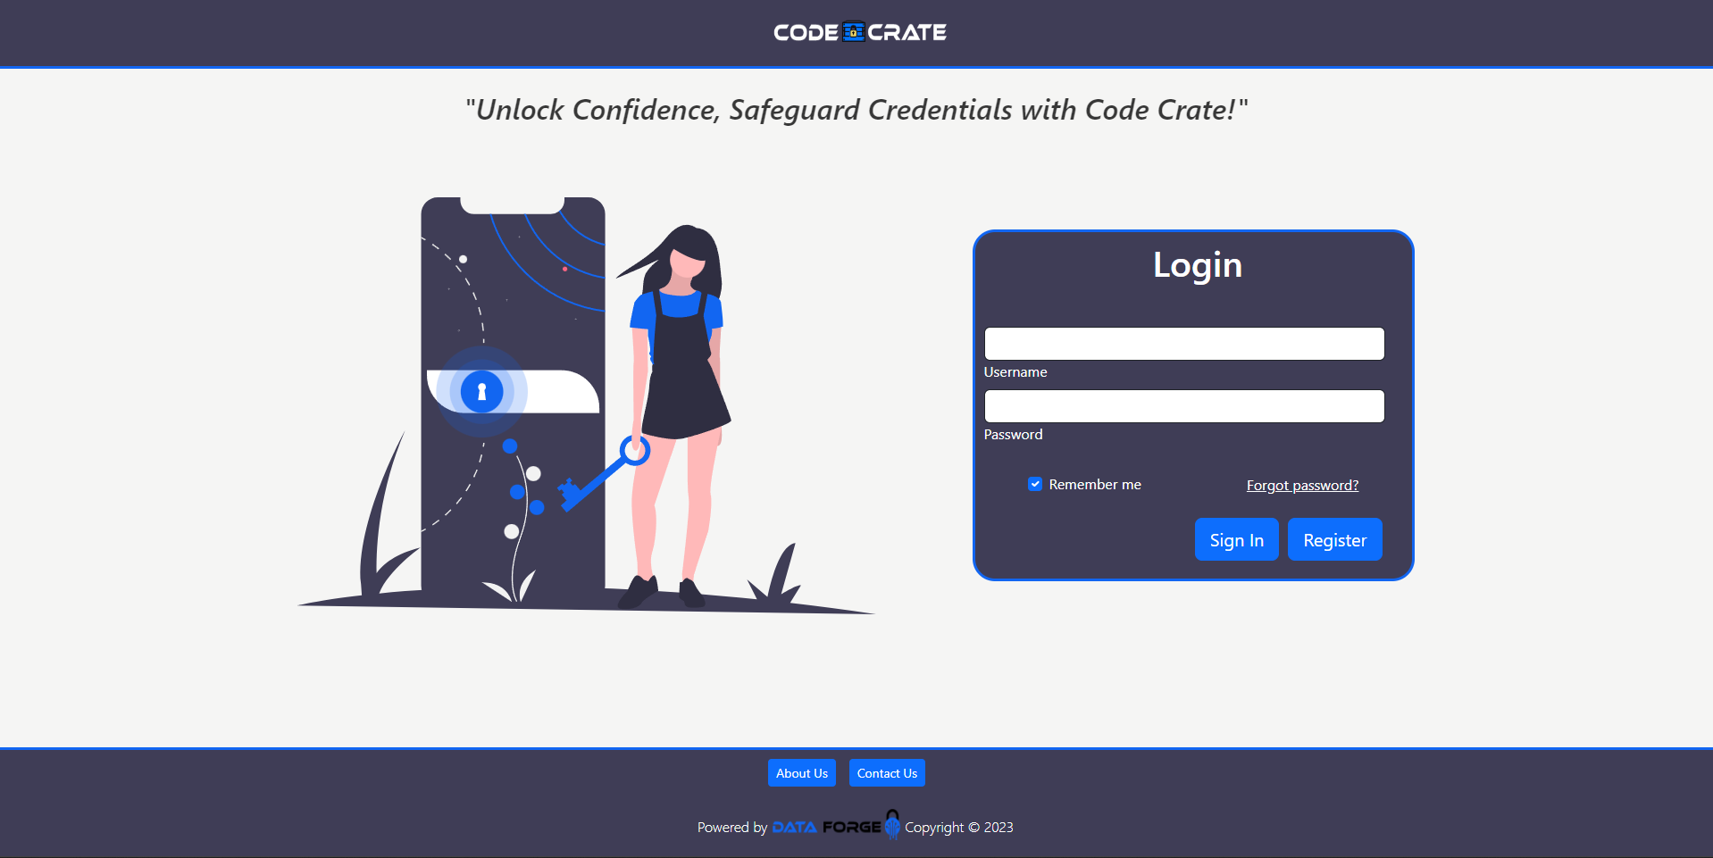
Desktop LOGIN PAGE view
This will be the first page the initializes on startup.
User-friendly design across the page and a consistent theme.

Slide 5
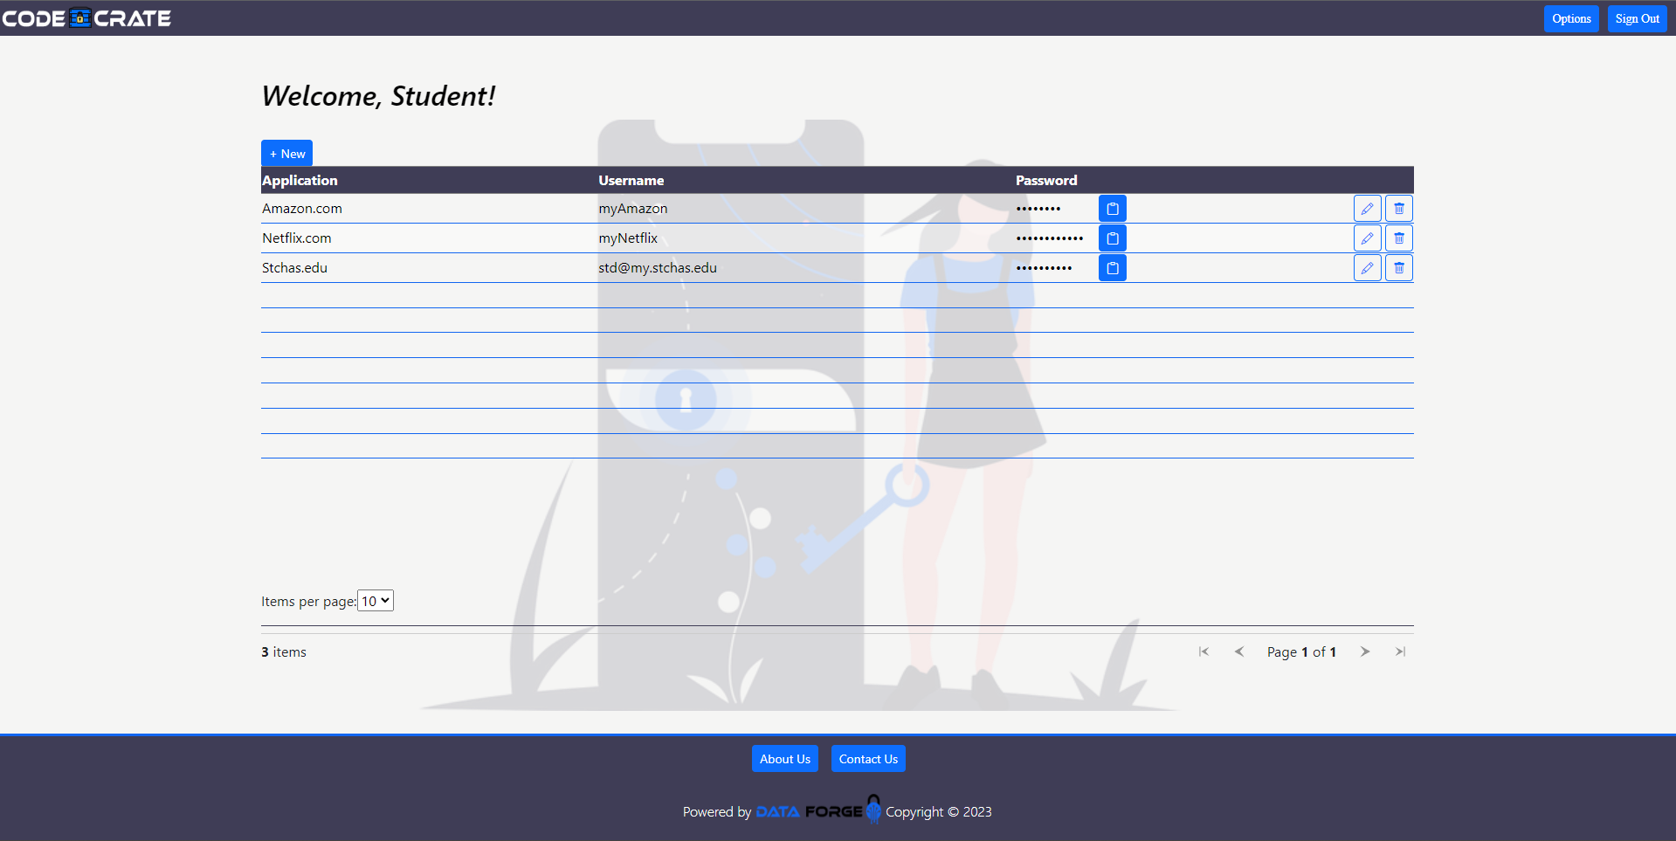
Desktop MAINDASHBOARD VIEW

Slide 6
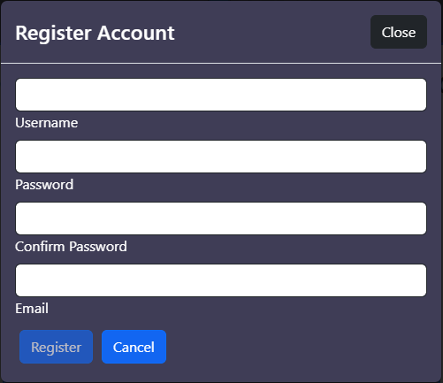
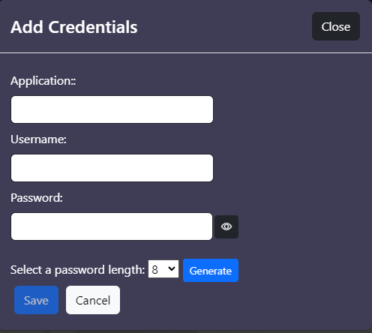
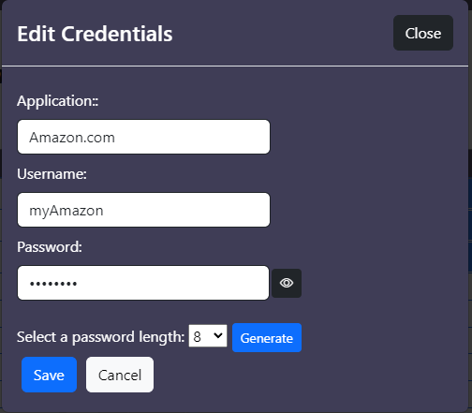
The Modals
When registering an account, you will see top image.
When creating a new credential, you will see the bottom left image
When editing a credential, you will see the bottom right image.

Slide 7
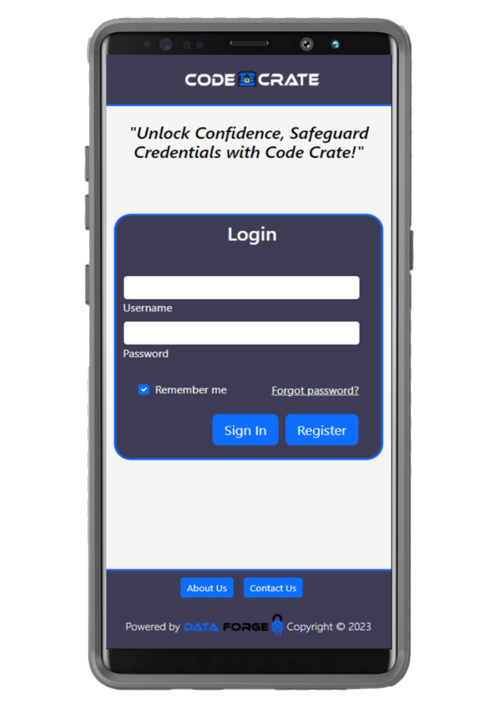
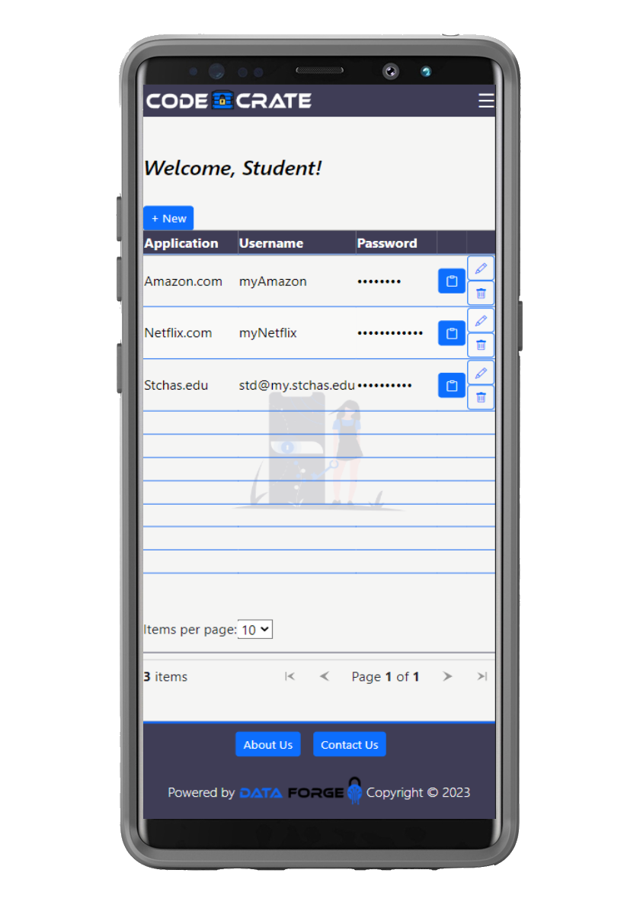
Cell Phone View
Blazor is a great tool for having a responsive web design because we can use CSS stylesheets to make our components work with cellular devices!
With a few conditionals in the stylesheet, we can achieve what you see on the left.
The image represents a Samsung S8 Ultra

Slide 8
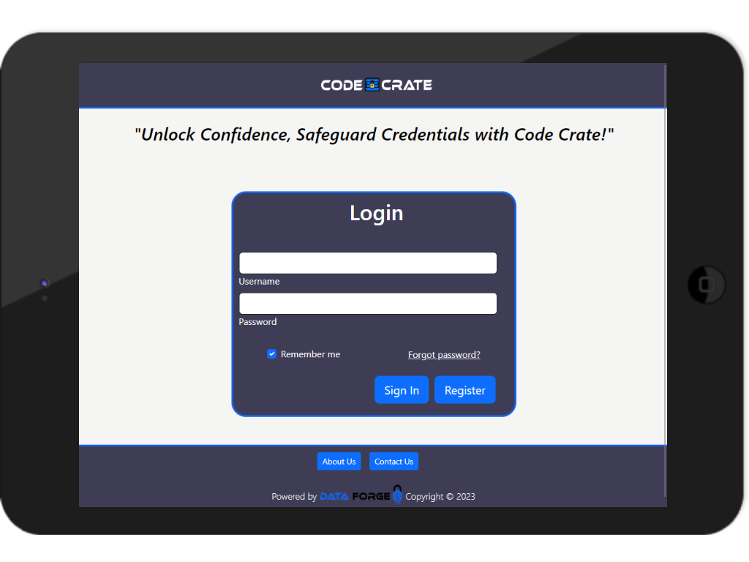
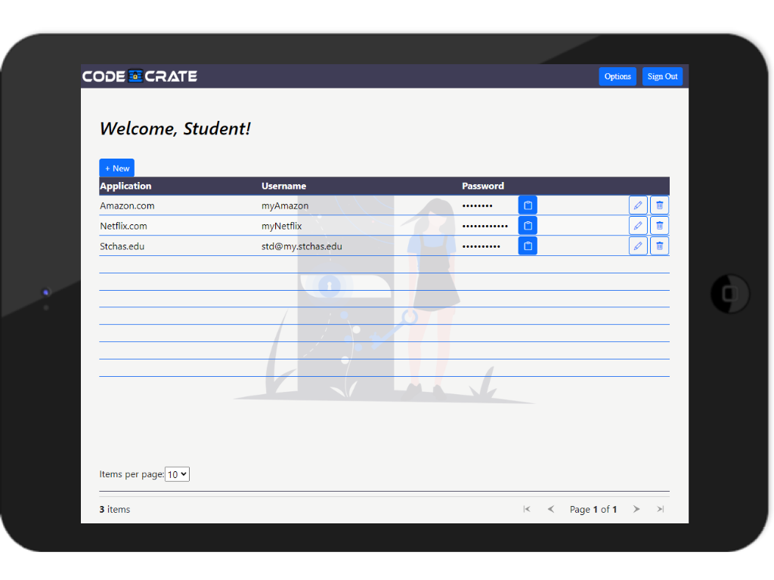
Tablet View - horizontal
Our web application can also work with tablets. The image to the left is an iPad Mini.
This responsive design allows clients to use our app vertically or horizontally.
You can scroll on the horizontal screen and the vertical screen if needed.

Slide 9

Useable on all the current browsers
Chrome
Edge
Firefox
Safari
Notes:
Made possible using “Responsive web design.”

Slide 10
Ways of Interaction with the System
Create a new user account
Login to an existing user account
Fully manipulate stored data belonging to that user with CRUD operations
Create, Read, Update, Delete
Notes:
CRUD = Create, Read, Update and Delete.

Slide 11
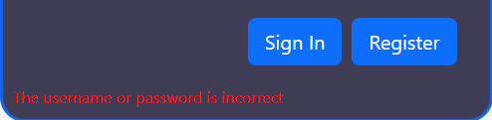
Login System Process
We have a Login Razor component that first loads up when the web application initializes.
This component uses our Validation service and our User Account service that we have created.
The Login Process:
The user enters their credentials
That service takes the data and runs a Validation check to see if it will find a match in the account database via username and password
If true, the Main Dashboard component will initialize and display all the user's credentials
If false, the user will be prompted with a "Username or Password is incorrect".

Slide 12
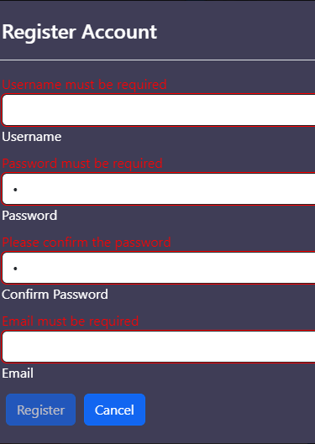
Register Account Process
The user is prompted with a Register Modal, which has several input fields.
The register button is "disabled" until all fields are filled AND meet the correct validation requirements. (See image)
This is achievable with the built in Form Validator that Blazor has.

Slide 13
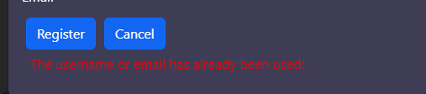
Register Account process part 2
A user CANNOT register another account to where the username and email have been already used. We do NOT want account duplicates in our database.
If the user tries registering an account that has already been created, they will be prompted with a message, see below.

Slide 14
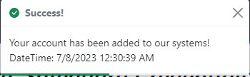
REGISTER ACCOUNT PROCESS PART 3
Once the user passes the form validator and duplicate account check, they will have officially added an account to our Account database.
The image to the right is what will show up on the login screen after account creation. These messages are called "Toasts".

Slide 15
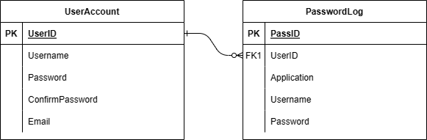
System Architecture
Front-End
Consist of Blazor components that use HTML,CSS, and C# code, which then uses our services.
Services
We have an Account Service that takes only account data, routes and/or manipulates the data before going to our database and back to the client.
The Credential Service is basically the same as the Account Service
We created a validation message service, which will consist of client-side message prompts
We created a CSV Data Service, which helps read and write to a CSV file.
We implemented a 3rd party service called, JS Interop Clipboard API, which allows the clients to copy their passwords directly to the clipboard with just a click of a button.
We implemented a password generator for the client to use in order to create secure/strong passwords.
Back-end
So far, the back-end only consists of 2 CSV files
Account Data Csv
For us to display the correct credentials for each separate user, we needed to have a one-to–many relationship with our database. This means that for each account there are many credentials. We can achieve this by using the UserID key as a relationship between the two tables.

Slide 16
What’s Next?
More polish on site design
Front-end team will perform more quality passes on the web portal design.
Database Encryption
Back-end team will implement a proprietary cypher to scramble the stored data.
Two-Factor Authentication
Allow the user to assign a TOTP (time-based one-time password) for logging into their Code Crate account.
Notes:
Front-end team: Bailey and Ryan
Back-end team: Connor and Phuong
CONNOR WILL DESIGN THE CYPHER

